Slide 1
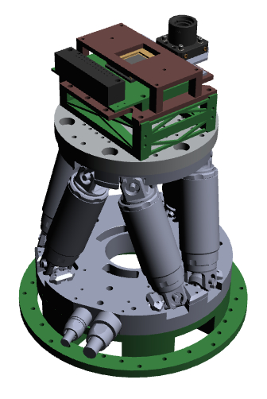

Development of a Simulated Star Field to Confirm Operation of Hexapod Resolution Enhancement System (HERESY)
ASU/NASA Space Grant
Intern: Ravi Prathipati
Mentors: Paul Scowen & Alex Miller

Slide 2
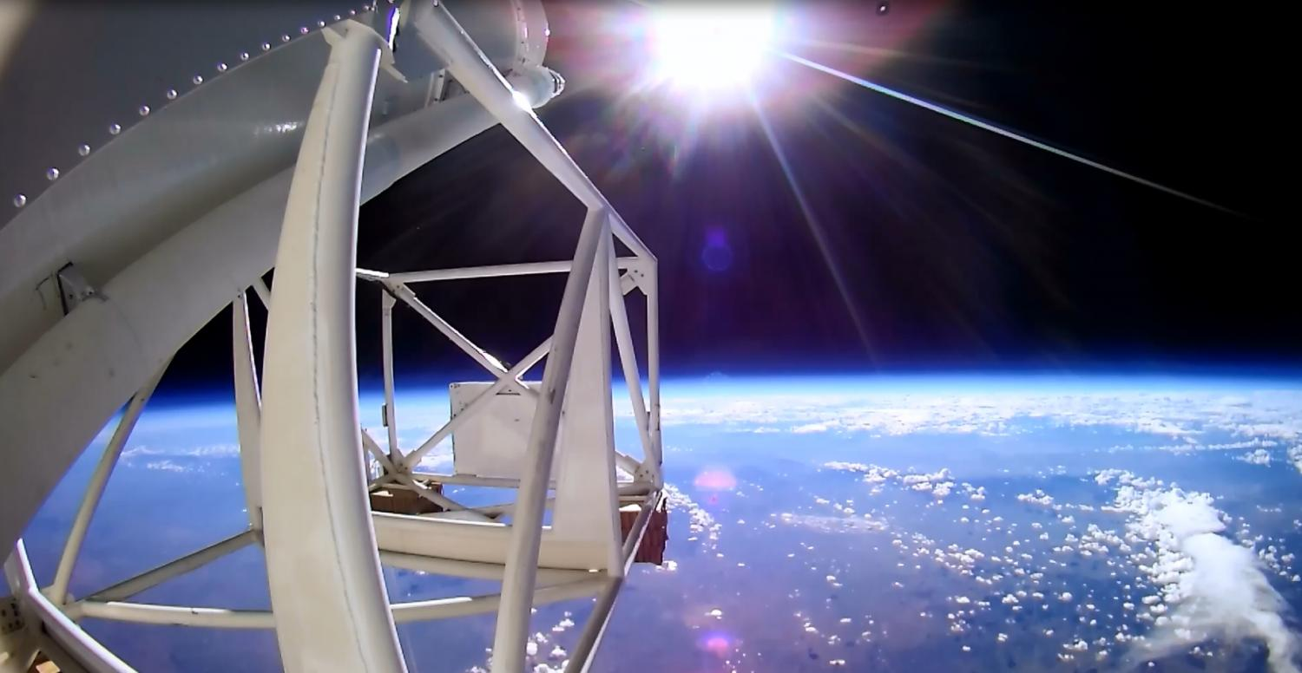
Project Goals:
Create an instrument strategy to decrease stability jitter to allow telescope pointing from 1’’ to 0.1”.
Obtain space based telescope resolution from a balloon platform

Slide 3
Problems with Balloon Observing
  Current gondola tech delivers 1” pointing but cannot correct for micron-level jitter movements imparted on the focal plane
Vibrations and Jitter!
  High-altitude winds moving over control surfaces
  On-board mechanisms such as cryocoolers, gyroscopic stabilization and pumps that are imparted to the focal plane
  Imposes a limit on gondola pointing

Slide 4
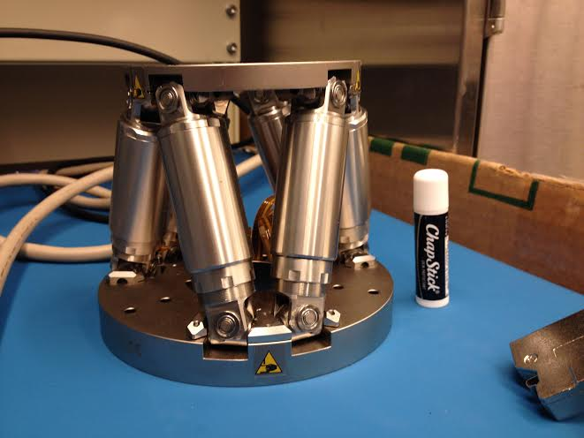
Physik Instrumente (PI) → H811-V

Slide 5
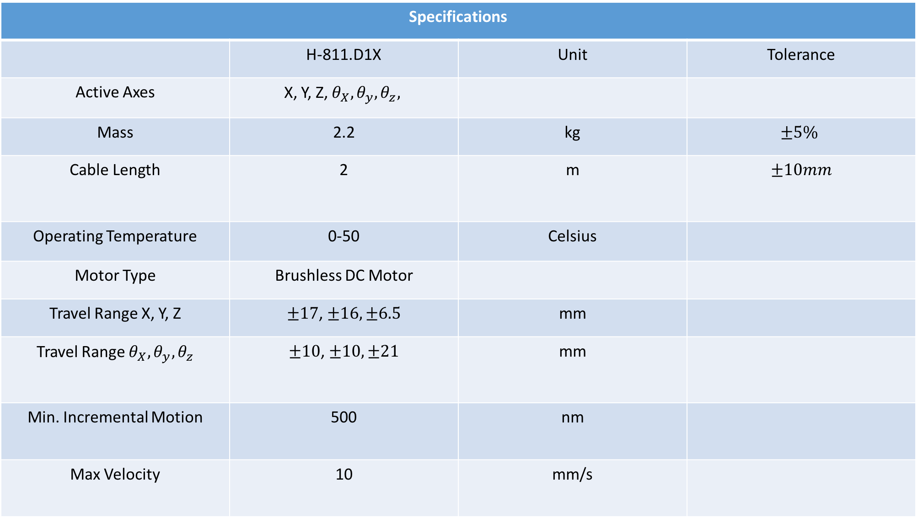
Specifications
 | H-811.D1X | Unit | Tolerance
Active Axes | X, Y, Z, $θ_{X}, θ_{y}, θ_{z},$
Mass | 2.2 | kg | $$±5\%$$
Cable Length | 2 | m | $$±10mm$$
Operating Temperature | 0-50 | Celsius
Motor Type | Brushless DC Motor
Travel Range X, Y, Z | $±17$, $±16, ±6.5$ | mm
Travel Range $θ_{X}, θ_{y}, θ_{z}$ | $±10$, $±10, ±21$ | mm
Min. Incremental Motion | 500 | nm
Max Velocity | 10 | mm/s

Slide 6
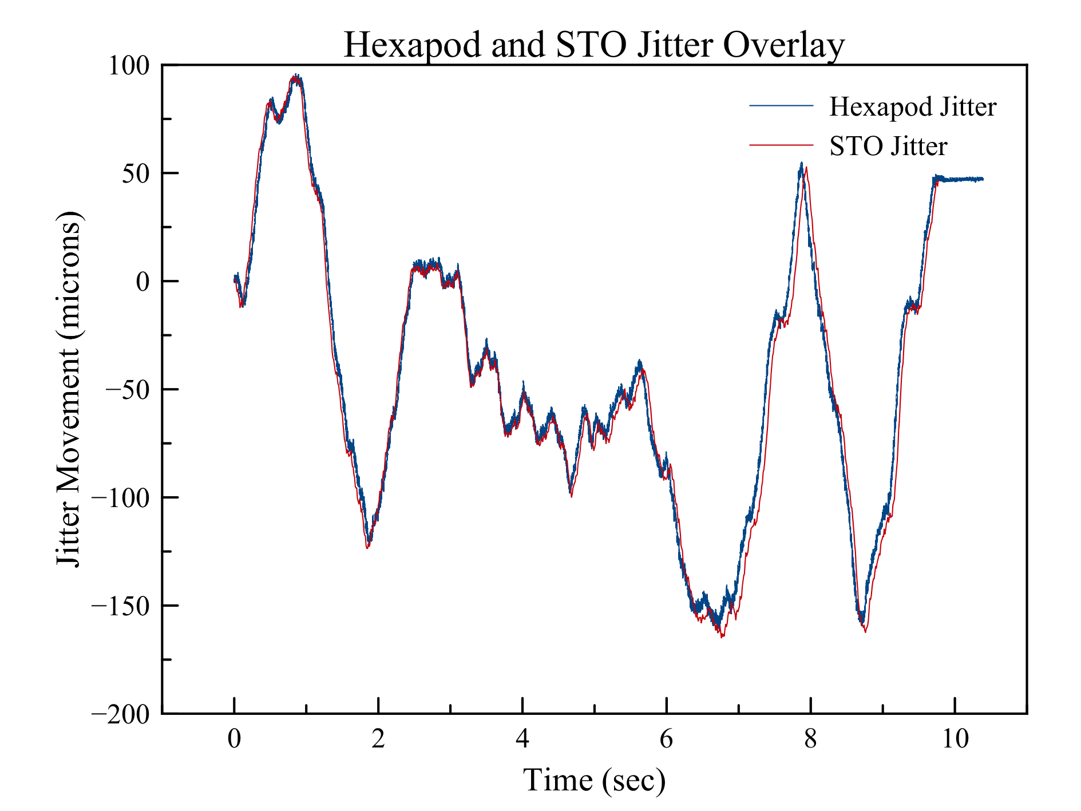
Hexapod and STO Jitter Data
Hexapod Accuracy:
Graph showing the hexapod’s capability to match jitter and vibrational movements recorded from the STO balloon mission.

Slide 7
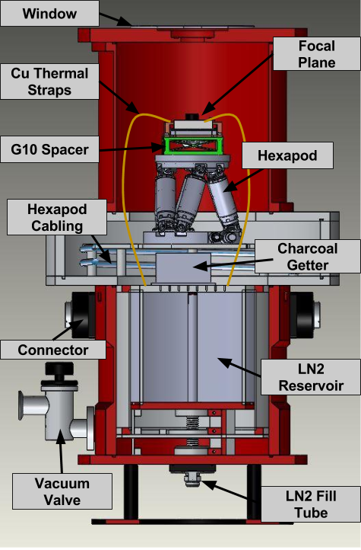
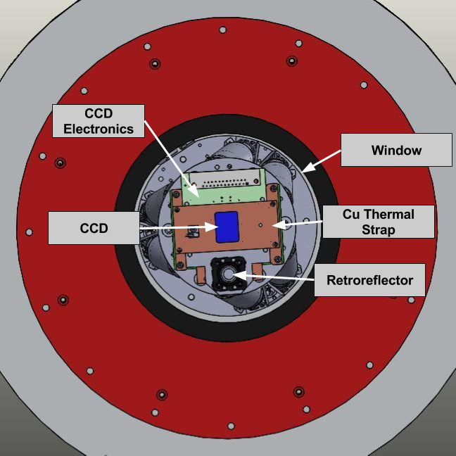
CAD Models of Hexapod’s Integration into Dewar

Slide 8
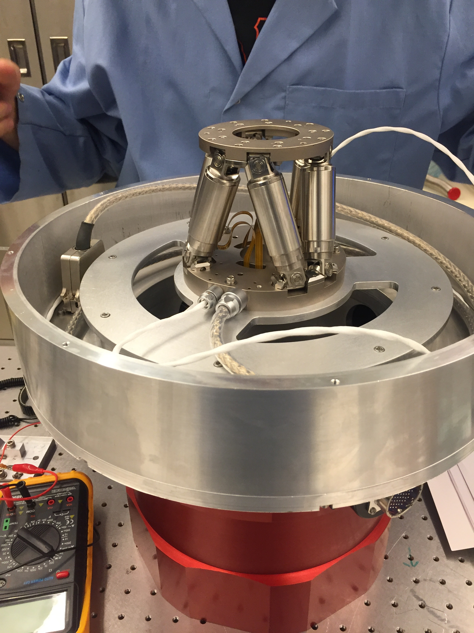
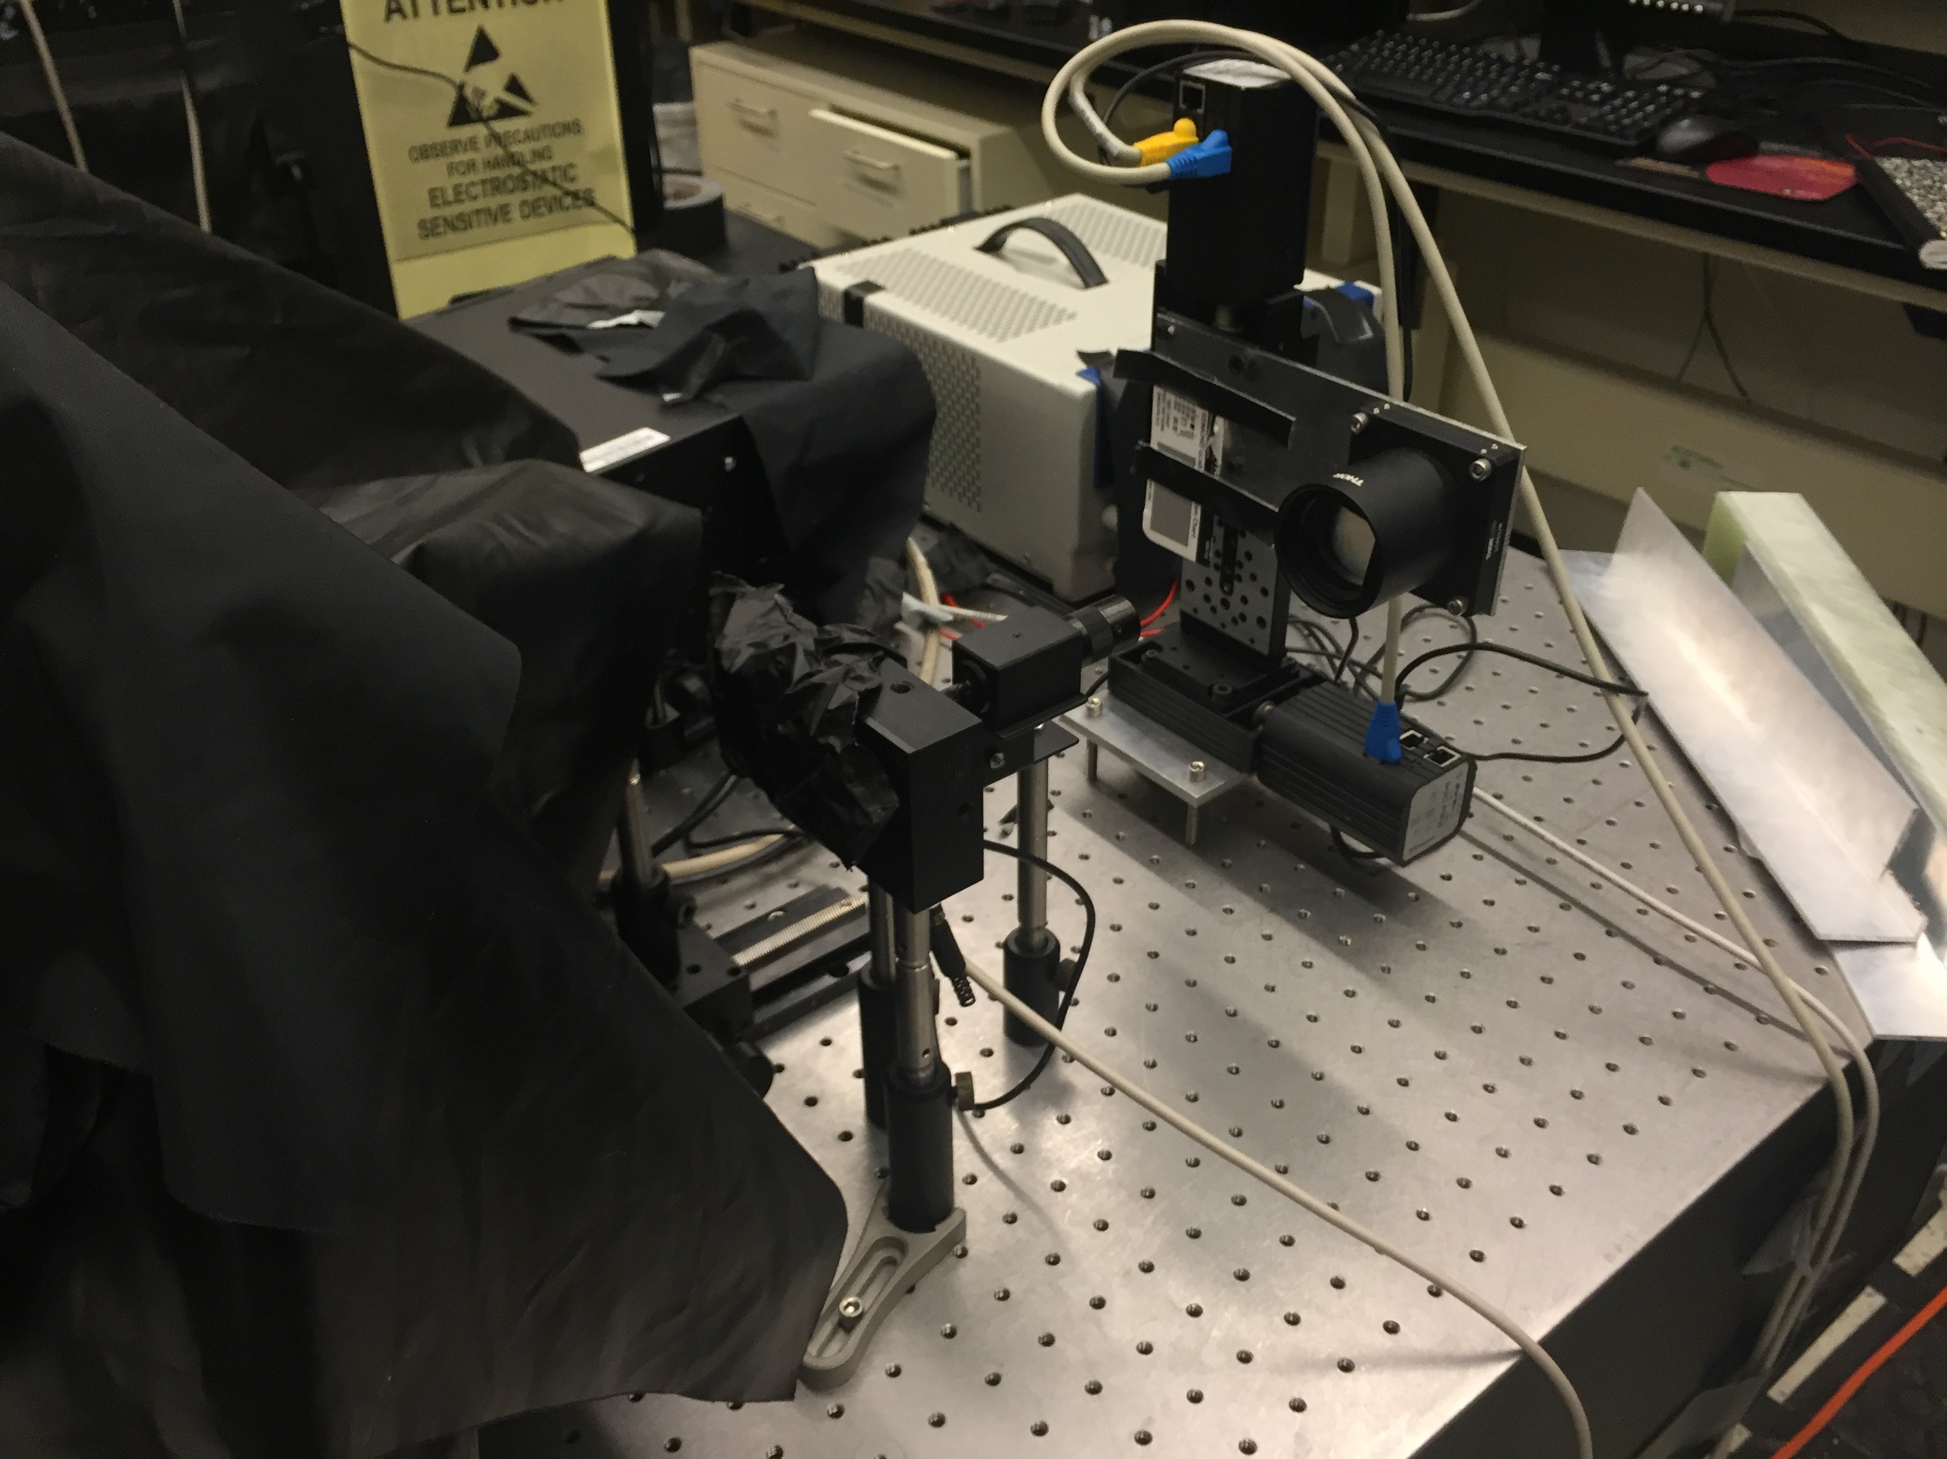
Implementation

Slide 9
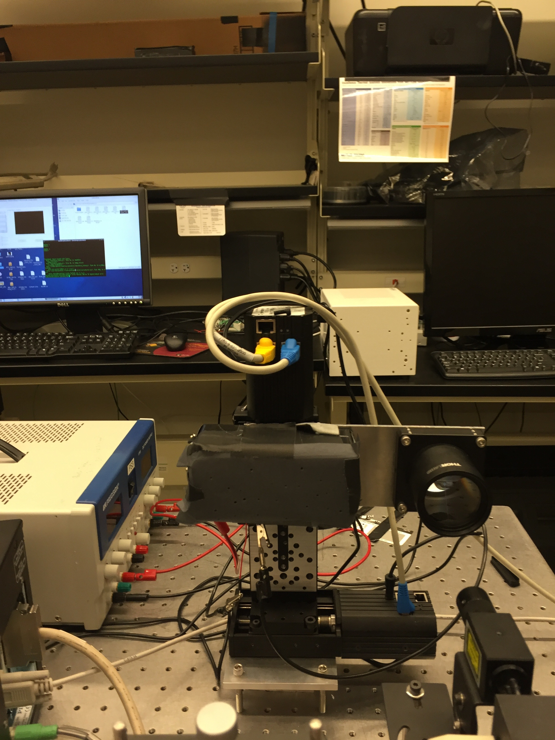
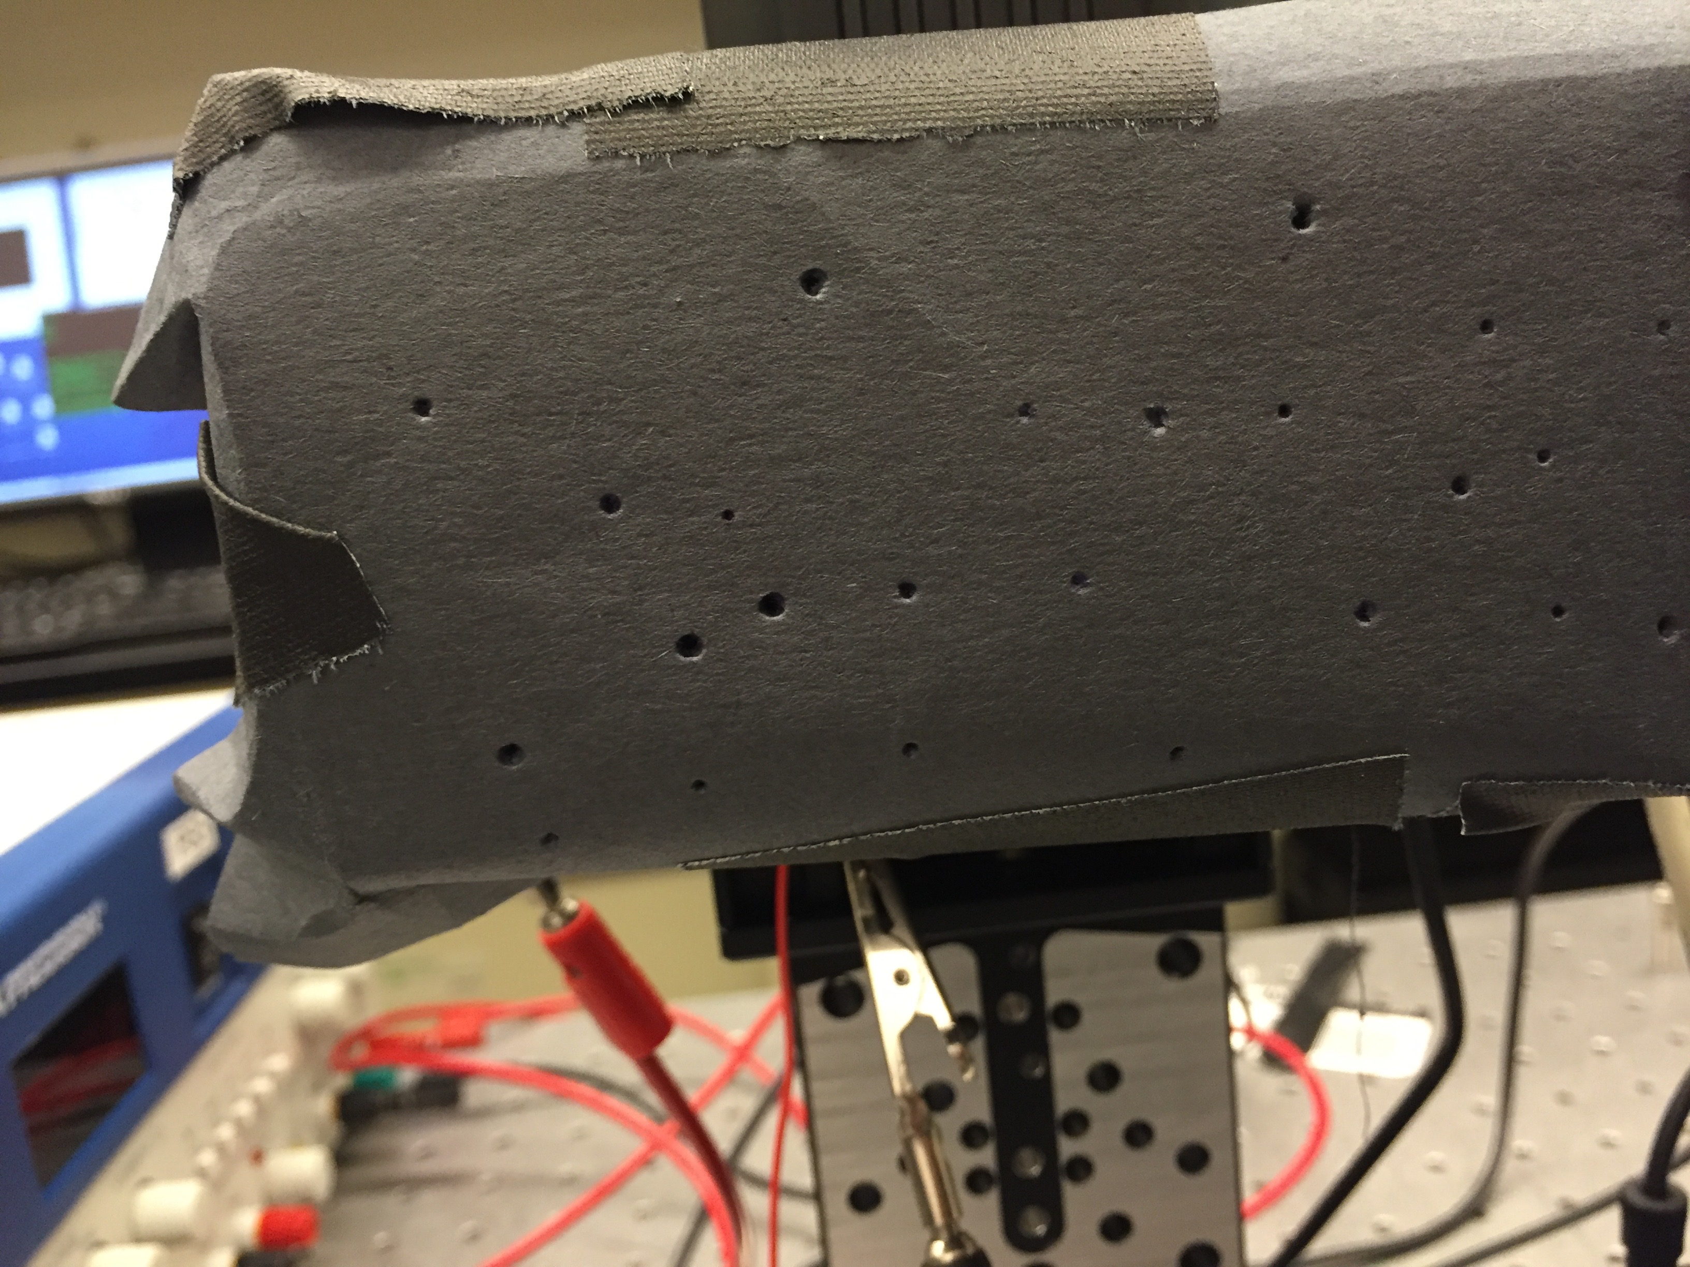
XY Stages and Star Field

Slide 10
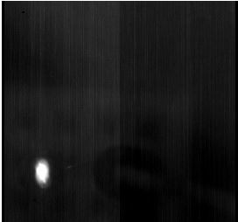
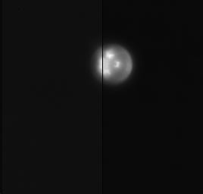
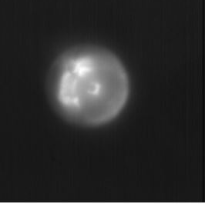
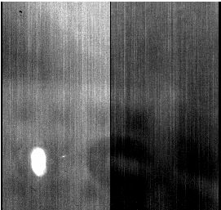
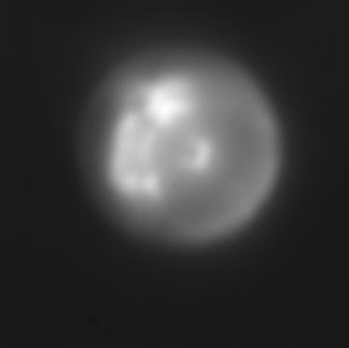

Slide 11
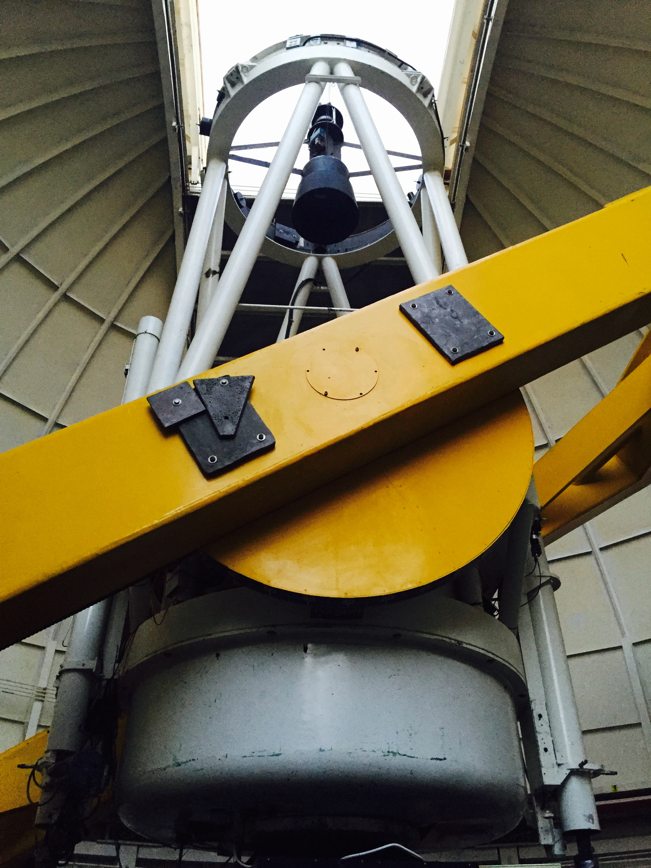
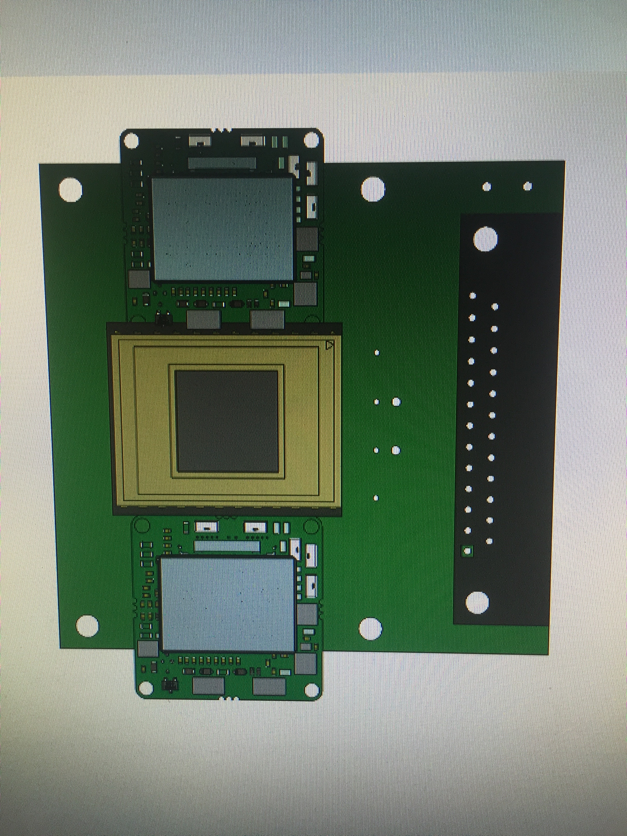
Future Work
Left: 61” Telescope at Mt. Bigelow
Right: Future Plans for adding star trackers to existing PCB board

Slide 12
References
Bernasconi, P. N. "The Stratospheric Terahertz Observatory." John Hopkins APL
Technical Digest 28.3 (2010): 238-39. Web.
"H-811 6-Axis Miniature Hexapod." PI Motion and Positioning. PI, n.d. Web.
NSF.gov, WHT Durham Univ.
Acknowledgements
Dr. Paul Scowen, ASU/NASA Space Grant, Alex Miller, Rhonda Holton and Ronnie Ramirez

Slide 13
Thank You!
Any Questions?
For more information about LASI:
  https://www.youtube.com/watch?v=B2RSSSJw81I

Slide 14
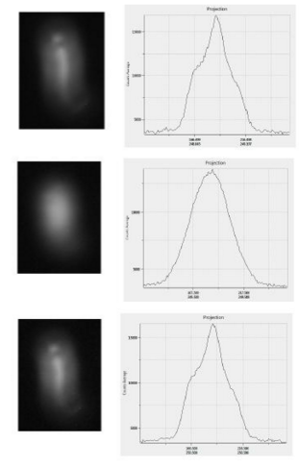
Images from Star Field
The top is a 60 second exposure of the incandescent bulb while all stages were stationary,
The middle image is an exposure while only the target stages were driven with the STO jitter resulting in a blurred image,
The bottom exposure while the target stages were again driven with the jitter signal and this time tracked by the hexapod. Hexapod tracking allowed structural information from the image to be preserved.

Slide 15
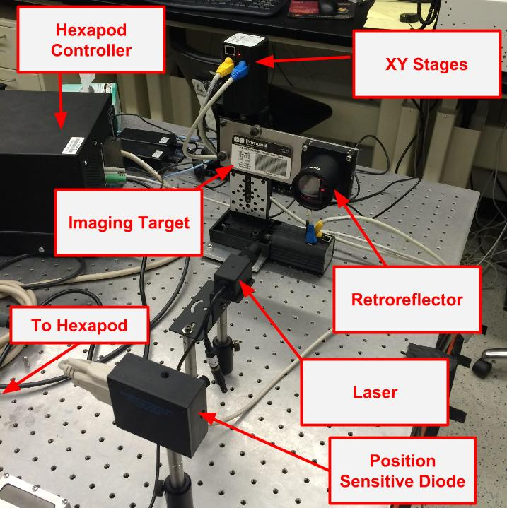
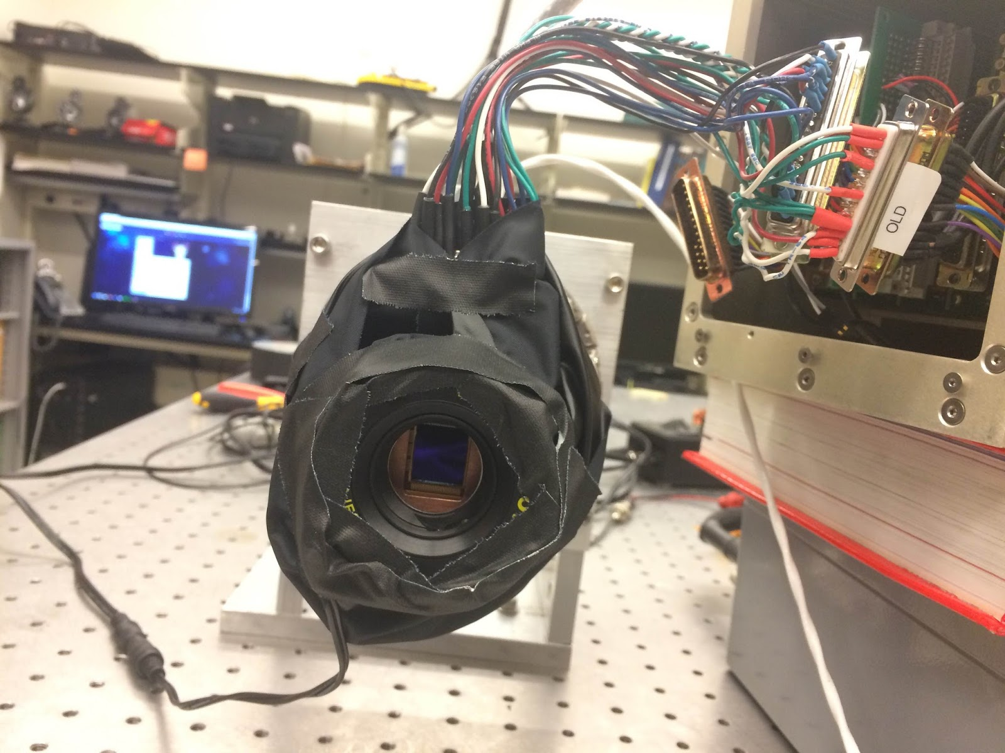

Slide 16
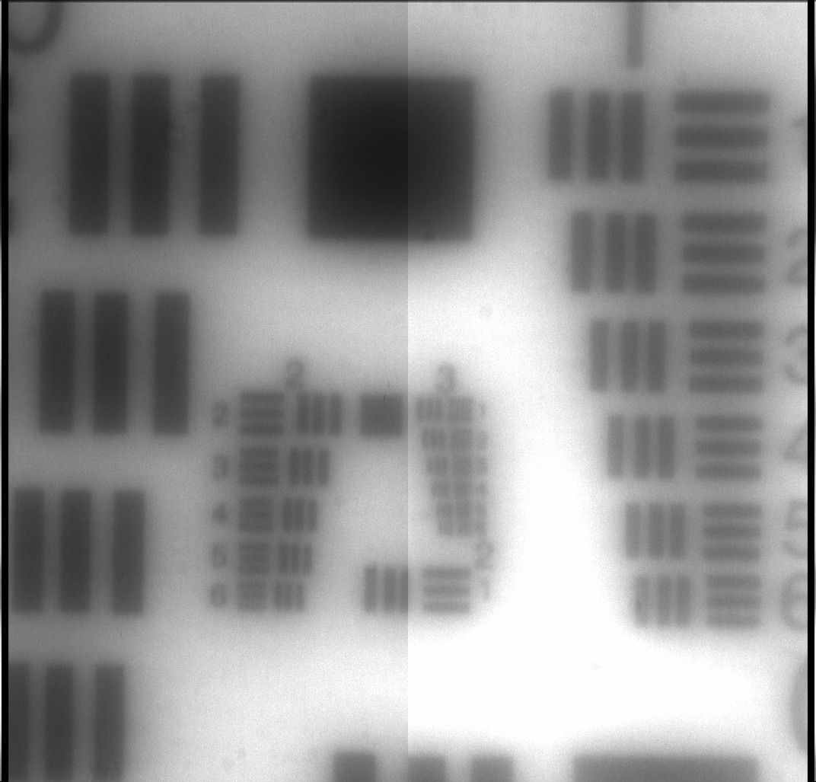
USAF Imaging Target

Slide 17
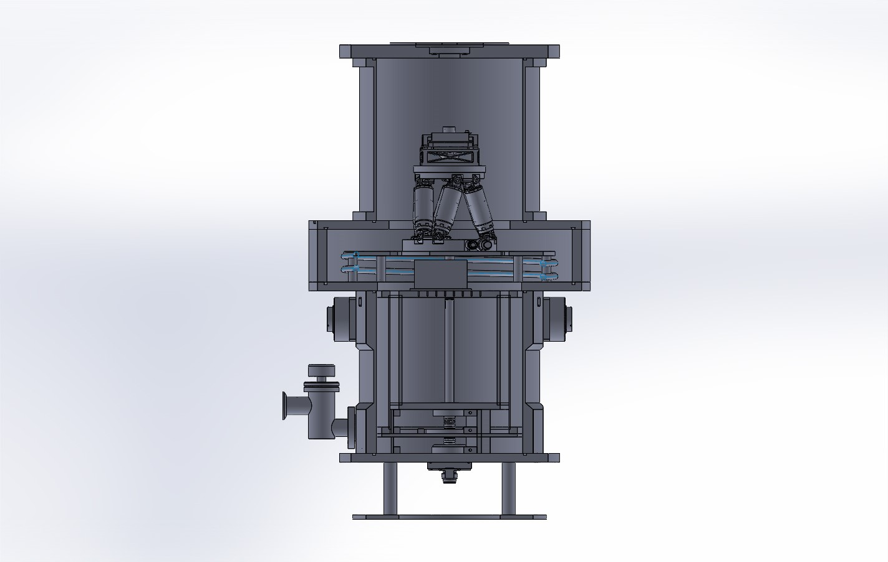
UCryo providing vacuum feed-through solution for hexapod
  Added benefit of heatsinking the hexapod for increased thermal stability

Slide 18
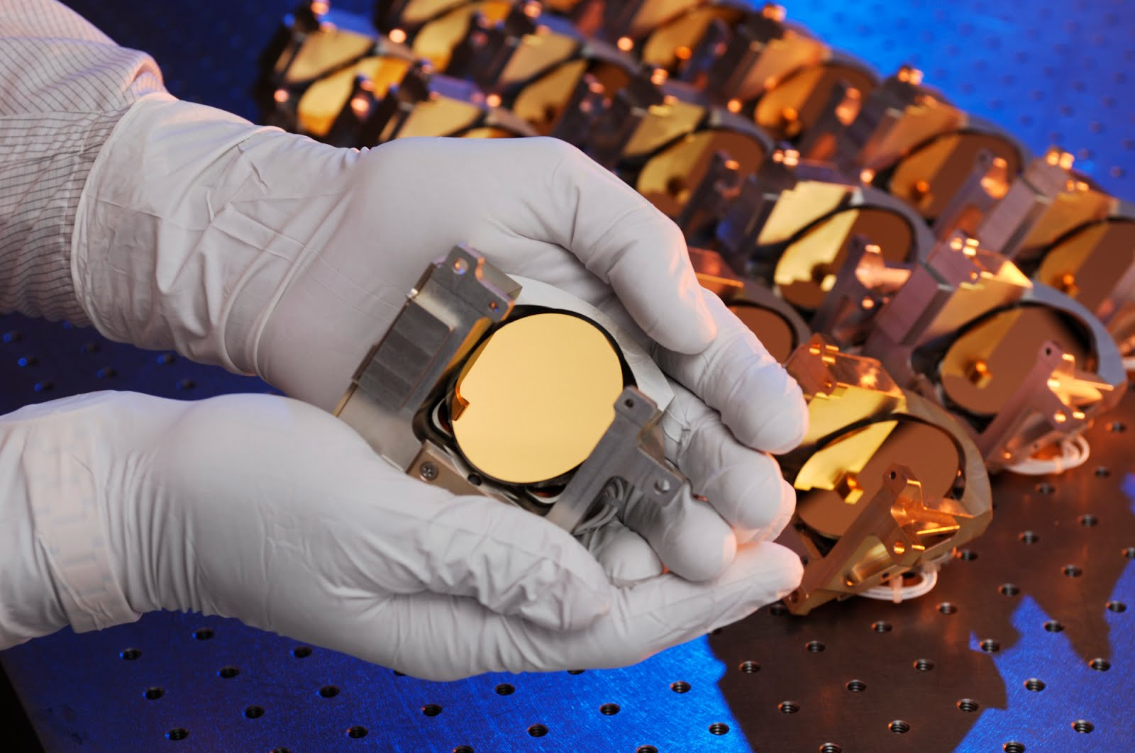

Hexapod vs. FSM
Fast-steering mirror:
  Additional reflection causes loss of photons
  Can’t easily ‘plug-in’ to different optical systems
Hexapod:
  Easy to ‘plug-in’ to different optical systems
  No additional reflections

Slide 19
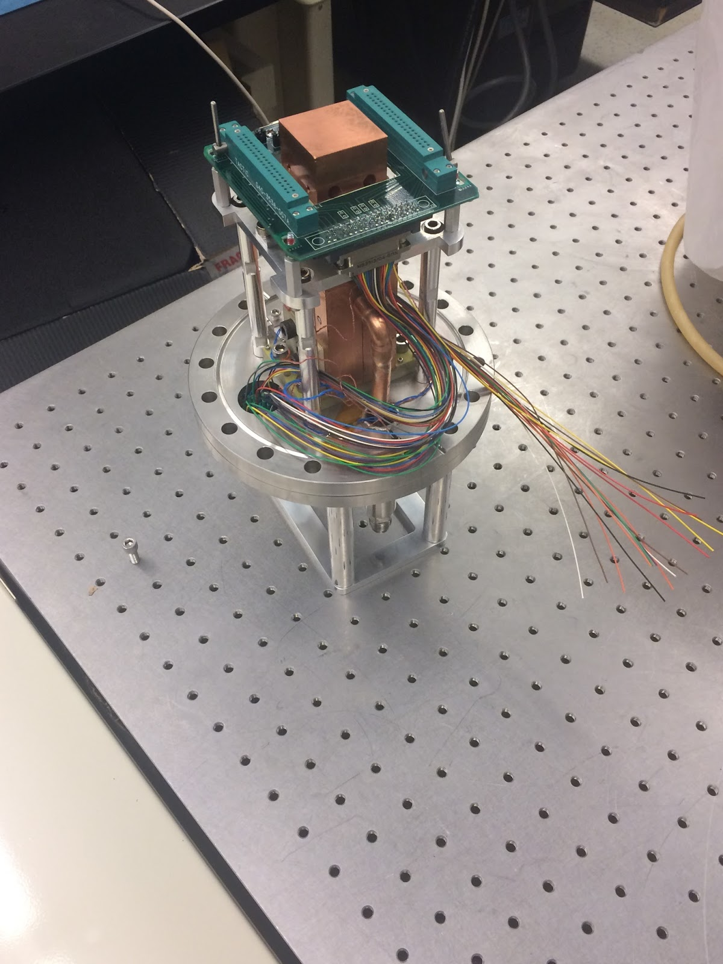
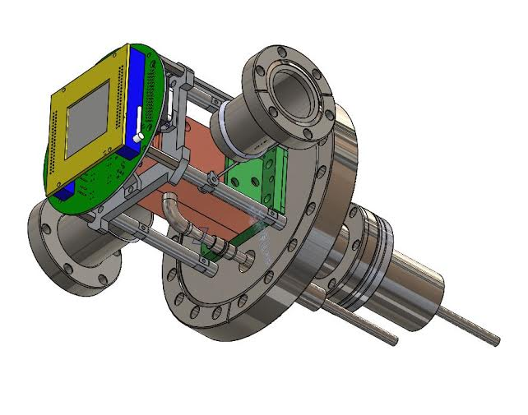
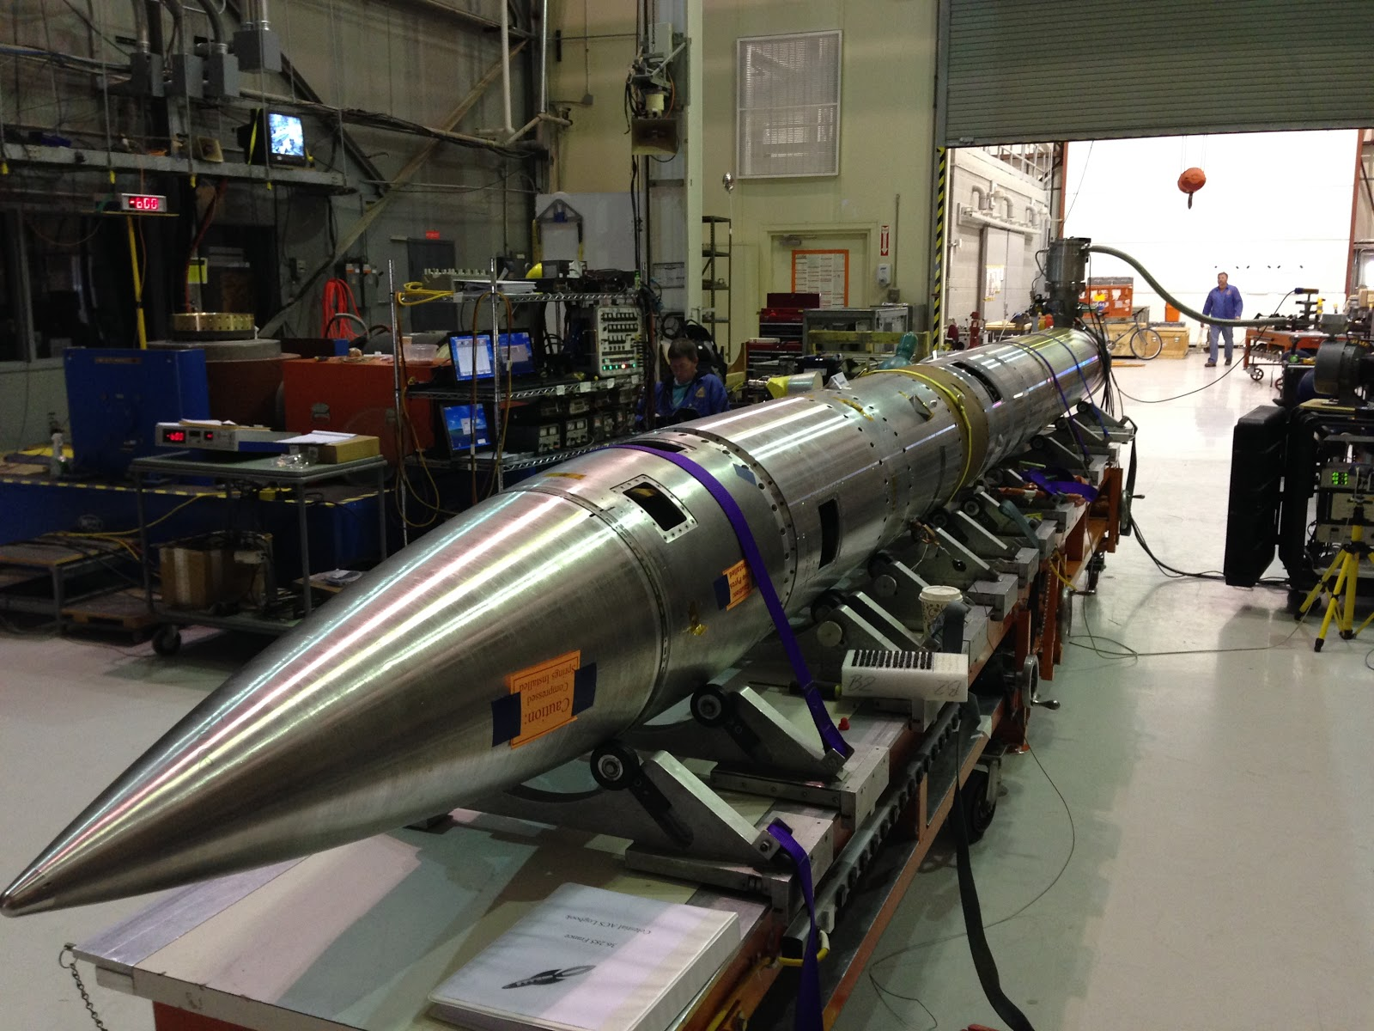
CHESS (ASU, JPL, CU-Boulder)

